Slide 1
Activate Wellbeing Toolkit Additional Activities and Tools
Version March 10, 2023
Notes:
Integrate any of these tools and activities into your slide deck, as appropriate for your unit’s unique context and needs.

Slide 2
Optional Activities and Tools
Activities
Multisolving flower – to ensure actions and plans address multiple critical issues (e.g. inclusion, Indigenous human rights, climate, wellbeing, anti-racism)
Systems Thinking Iceberg – A tool for guiding system thinking
Revisit Progress – Discussion and reflection questions after implementing prioritized actions
Wellbeing moments
Mood Checker– a useful opening activity / icebreaker (10-15 minutes)
Movement break (5 or 10 minutes)
Mindfulness break (1 minute)
Tools
Gradients of agreement – A tool to help with group decision making
Notes:
Note to facilitator:
Choose which tools and activities you wish to use and integrate them into your main slide deck

Slide 3
Multisolving Flower Planning and Evaluation Tool

Slide 4
Multisolving Flower planning and evaluation tool
A tool for evaluating potential co-benefits OR barriers of projects, initiatives, or policies through the lens of various UBC mid-level institutional plans.
This tool can help you highlight and consider your approach to advancing sustainability, decolonization, equity, and wellbeing while advancing student and employee experience.
This tool can be used in your planning, reflection, and/or communication stage to plan, evaluate, and communicate how your action is advancing the various UBC mid-level plans.
Tool adapted from www.multisolving.org
Notes:
The multisolving tool has been adapted from www.multisolving.org.
If you wish to learn more about multisolving, there are many webinars available at the Multisolving Institute’s website above.
The next few slides provide:
A template
2 examples of how the multisolving flower has been used

Slide 5
Template
Co-benefits of our approach
Advances Sustainability goals by: …
Advances Focus on People by: …
Climate protection
Advances Student Strategic Plan by: …
Student experience
Employee Experience
Project
Name
…
Advances Wellbeing Strategic Framework by: …
Health & wellbeing
Equity, diversity & inclusion
Indigenous human rights, decolonization, & reconciliation
Advances Indigenous Strategic Plan by: …
Advances Inclusion Action Plan by:
…
Notes:
How to use the multisolving flower when planning your project or initiative:
Co-benefit assessment
Place your project name at the center
For each petal, consider if your project or initiative is advancing this element
If your project is advancing that petal, capture a few points about how it is doing so
If your project is not advancing that petal, consider if there are ways you can adjust your approach to advance the petal. (Refer to UBC’s Plans and Strategies such as the Indigenous Strategic Plan and Inclusion Action Plan, and their self-assessment tools for opportunities)
If there are no opportunities, note “Not advancing this theme”
OR Barrier assessment
Place your project name at the center
For each petal, consider if there are any ways your approach could be presenting barriers to the various petals.
If your project presents any potential barriers to that petal, capture a few points about how in the space provided.
If your project has any barriers, consider if there are ways you can adjust your approach to reduce or remove the barriers.
If there are no barriers, note “No barriers”

Slide 6
EXAMPLE: Co-benefits of UBC’s approach to promoting food security
Advances Sustainability goals by reducing food waste, capacity building, access to plant-forward food options
Advances Affordability Plan and financial savings to UBC with student recruitment and retention, reduced health services, etc.
Climate protection
Student experience
Advances Student Strategic Plan by: Students better able to participate in UBC experience, succeed in class, build literacy
Economic
Food
Security
Health & wellbeing
Equity, diversity & inclusion
Advances Wellbeing Strategic Framework by: Regular nutritious meals, reduced stress & anxiety, social connection and community building
Indigenous human rights, decolonization, & reconciliation
Advances Inclusion Action Plan by low-barrier dignified access to food benefitting equity-deserving groups + celebrating community and culture through food and community space.
Advances Indigenous Strategic Plan by: Supporting Indigenous Food Sovereignty by addressing underlying issues and self-determination in access and use of food
Notes:
Notice here, the group that used this tool changed one of the petals to suit their needs (Employee Experience changed to Economic).
How to use the Multisolving Flower for a Co-benefit assessment
Place your project name at the center
For each petal, consider if your project or initiative is advancing this element
If your project is advancing that petal, capture a few points about how it is doing so
If your project is not advancing that petal, consider if there are ways you can adjust your approach to advance the petal. (Refer to UBC’s Plans and Strategies such as the Indigenous Strategic Plan and Inclusion Action Plan, and their self-assessment tools for opportunities)
If there are no opportunities, note “Not advancing this theme”

Slide 7
Template
Barriers of our approach
Barriers to Sustainability goals: …
Barriers to Focus on People:
…
Climate protection
Barriers to Student Strategic Plan:
…
Student experience
Employee Experience
Project
Name
…
Barriers to Wellbeing Strategic Framework: …
Health & wellbeing
Equity, diversity & inclusion
Indigenous human rights, decolonization, & reconciliation
Barriers to Indigenous Strategic Plan: …
Barriers to Inclusion Action Plan:
…
Notes:
How to use the multisolving flower when planning your project or initiative:
OR Barrier assessment
Place your project name at the center
For each petal, consider if there are any ways your approach could be presenting barriers to the various petals.
If your project presents any potential barriers to that petal, capture a few points about how in the space provided.
If your project has any barriers, consider if there are ways you can adjust your approach to reduce or remove the barriers.
If there are no barriers, note “No barriers”

Slide 8
EXAMPLE: Possible barriers presented by the event
Barriers to Sustainability: Participant travel (GHG emissions), Food and packaging waste from catering.
Barriers to Focus on People:
No barriers.
Climate protection
Student experience
Barriers to Student Strategic Plan: Potential to exclude student perspective if we don’t intentionally work to include student voices in this staff/faculty focused event.
Employee experience
Hosting Staff & Faculty Event
Health & wellbeing
Equity, diversity & inclusion
Barriers to Wellbeing Strategic Framework: With so much content to cover - how do we embed movement breaks? Potential for our low budget to limit nutritious food options
Indigenous human rights, decolonization, & reconciliation
Barriers to Inclusion Action Plan: Difficult for some equity-deserving staff/faculty groups to attend due to nature of work & scheduling constraints.
Barriers to Indigenous Strategic Plan: If we don’t slow down, build relationships, and find Indigenous partners & panelists we won’t center Indigenous voices
Notes:
This example shows the use of the multisolving tool while planning a faculty and staff event
How to use the Multisolving Flower for a barrier assessment
Place your project name at the center
For each petal, consider if there are any ways your approach could be presenting barriers to the various petals.
If your project presents any potential barriers to that petal, capture a few points about how in the space provided.
If your project has any barriers, consider if there are ways you can adjust your approach to reduce or remove the barriers.
If there are no barriers, note “No barriers”

Slide 9
Systems Thinking Iceberg

Slide 10
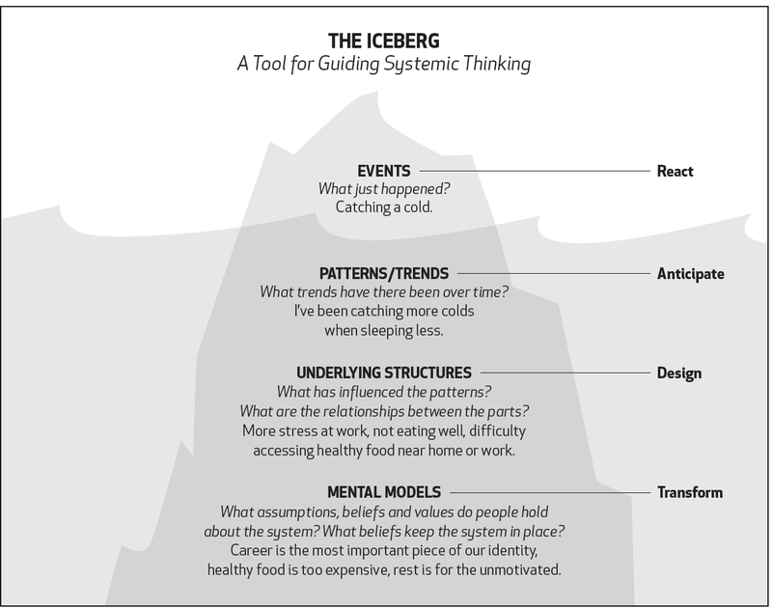
Ecochallenge.org
Increasing leverage
Notes:
Policy change is at the structure level. As you’ve probably witnessed in your life, policy changes don’t always work as intended. This diagram shows why. If policy change isn’t supported by hard conversations that align worldviews, generate greater understanding and create a culture shift, they can come up short. We must ask: What worldview shifts and alignments are needed to support the policy?
Systems thinking is a way of approaching problems that asks how various elements within a system — which could be an ecosystem, an organization, or something more dispersed such as a supply chain — influence one another. Rather than reacting to individual problems that arise, a systems thinker will ask about relationships to other activities within the system, look for patterns over time, and seek root causes.
One systems thinking model that is helpful for understanding global issues is the iceberg model. We know that an iceberg has only 10 percent of its total mass above the water while 90 percent is underwater. But that 90 percent is what the ocean currents act on, and what creates the iceberg’s behavior at its tip. Global issues can be viewed in this same way.
Credit to: www.ecochallenge.org

Slide 11
Ecochallenge.org
Structures can include:
– Built environments
– Policies
– Governing structures
Notes:
Levels of thinking - Example 1
1. The Event Level
The event level is the level at which we typically perceive the world—for instance, waking up one morning to find we have caught a cold. While problems observed at the event level can often be addressed with a simple readjustment, the iceberg model pushes us not to assume that every issue can be solved by simply treating the symptom or adjusting at the event level.
UBC example: student makes decision about eating less food because they are running out of money for the month and rent is due
2. The Pattern Level
If we look just below the event level, we often notice patterns. Similar events have been taking place over time — we may have been catching more colds when we haven’t been resting enough. Observing patterns allows us to forecast and forestall events.
UBC example: increase cost of living, increase in students accessing AMS Food Bank, data shows high prevalence of food insecurity among UBC students
What structures and mental models does UBC have control over that would alleviate food insecurity?
3. The Structure Level
Below the pattern level lies the structure level. When we ask, “What is causing the pattern we are observing?” the answer is usually some kind of structure. Increased stress at work due to the new promotion policy, the habit of eating poorly when under stress, or the inconvenient location of healthy food sources could all be structures at play in our catching a cold. According to Professor John Gerber, structures can include the following:
Physical things — like vending machines, roads, traffic lights or terrain.
Organizations — like corporations, governments, and schools.
Policies — like laws, regulations, and tax structures.
Ritual — habitual behaviors so ingrained that they are not conscious.
UBC example: tuition increases, Graduate stipend levels
4. The Mental Model Level
Mental models are the attitudes, beliefs, morals, expectations, and values that allow structures to continue functioning as they are. These are the beliefs that we often learn subconsciously from our society or family and are likely unaware of. Mental models that could be involved in us catching a cold could include: a belief that career is deeply important to our identity, that healthy food is too expensive, or that rest is for the unmotivated.
UBC example: the starving student as a right of passage, shame in accessing support
Levels of thinking - Example 2:
Event: A co-worker who is Indigenous has left her UBC job for a position at another institution
Patterns: Trend of staff who are Indigenous leaving the unit
Structures: Emotional labour, burnout doing “regular” job and EDI work, recruitment and promotion practices
Mental models (implicit or actually stated): “Above and beyond” work and achievements are necessary for promotion in post-secondaries; Committee work is a normal part of life in a post-secondary for faculty and staff; Committee work does not constitute additional responsibilities in a job description; we are lucky to be working at such a great institution; A belief that you can decolonize the institution

Slide 12
Ecochallenge.org
Increasing leverage
Notes:
As a unit (or in pairs / small groups), select a recent event that strikes you as urgent, important or interesting (e.g. skipping lunch, high staff sick time, high amount of sedentary time in the work day, poor attendance at social events, etc)
On a blank sheet of paper, white board, or in an online shared document, write the event (what is observable about the event) at the top of the blank iceberg and work your way down through the patterns, underlying systems and mental models, adding as many as you can think of. It can also be useful to move up and down between levels as you think more about the event.
QUESTIONS TO CONSIDER AFTER TRYING OUT THE ICEBERG MODEL
Does the iceberg model help broaden your perspective? If so, how might this new perspective be helpful?
Consider the concept of entry, or “leverage” points. These are points at which to intervene in a system that could lead to systemic transformation. Does the exercise show you any new entry points at which you are inspired to intervene?
What issues that have frustrated you might be interesting to analyze with the Iceberg Model?
Credit to www.ecochallenge.org

Slide 13
Wellbeing Moments
Notes:
Credit to: www.ecochallenge.org

Slide 14
How are you feeling today?
Reflecting on our moods and emotions and expressing them can support workplace mental health and wellbeing. It is important to note that you can feel multiple emotions and moods at once!
Select what mood(s) you identify with today:
Calm
Stressed
Okay
Amazing
Stuck
Sad
Edgy
Grateful
Sensitive
Anxious
Peaceful
Inspired
Hopeful
Awkward
Blessed
Happy
Meh
Content
Notes:
Note to facilitator:
This activity can be a useful icebreaker / opening activity.
The activity allows participants to tune in to their own emotional state and that of others, and it can also bring participants into conversation.
This activity is designed to help facilitate discussion around mental health and guide employees toward a deeper understanding of moods and emotions through “mood labelling”.
Open the meeting with a roundtable, with each participant sharing their mood and speaking to it briefly.
Time commitment: 10-15 minutes depending on the number of participants

Slide 15
Movement break
Schedule a facilitated movement or wellbeing break through the MoveU Crew for UBC-V or UBC-O OR
Follow one of these videos

Slide 16
Mindfulness Moment
Mindfulness - 45 second breaks - Set up the video in advance (to also click through any advertising)
Nitobe waterfall: https://www.youtube.com/watch?v=5D3KCt-rE2s
Beach https://www.youtube.com/watch?v=6pa7AV5uPYc

Slide 17
Gradients of Agreement

Slide 18
Gradients of Agreement | Better Vocabulary
1
2
3
4
5
6
7
8
Agree with a minor point of contention
“Not perfect, but it’s good enough”
Whole-hearted endorsement
“I really like it”
Support with reservations
“I can live with it”
Abstain
“This issue does not affect me”
More discussion needed
“I don’t understand the issues well enough yet”
Don’t like but will support
“It’s not great, but I don’t want to hold up the group”
Serious disagreement
“I am not on board with this – don’t count on me”
Veto
“I block this proposal”
Source: The gradients of agreement scale (Kaner 2014, p. 278)
Notes:
Choosing which actions to prioritize may be challenging, especially with larger groups. If you run into challenges, this tool can help determine where teammates are on the gradient and how you can move forward together. Overall, remember that small actions are better than no action at all. What action can you agree to do next?
Refer to the Toolkit Facilitator’s Guide (confirm naming / link) for more considerations, such as power dynamics.

