Slide 1
Activate Wellbeing Toolkit
Unit
Date
Customizable Slide Deck | Version: June 28, 2023
Notes:
Notes to facilitator: Welcome to the slide deck to support use of the Activate Wellbeing Toolkit! For background of the Activate Wellbeing Toolkit, please go to: www.wellbeing.ubc.ca
Please download a copy of this slide deck and customize it as you see fit for your unit’s unique context. The yellow highlights reflect content that you will customize.
Download the Preparing for Success Guide and Facilitators Handbook from www.wellbeing.ubc.ca/AWT
The Office of Wellbeing Strategy and HR Health, Wellbeing & Benefits teams can provide consultative support to UBC faculty, units, and departments that are planning session(s)/ discussion(s) around the Activating Wellbeing Toolkit. Contact ubc.wellbeing@ubc.ca with your questions or request and someone from our team will be happy to connect with you.

Slide 2
Note to planning team and facilitator
Welcome to the slide deck to support the use of the Activate Wellbeing Toolkit (AWT).
Use as much or as little of the toolkit and slide deck as you want, to match your unit’s capacity and needs.
Instructions
Use the Preparing for Success Guide and Facilitators Handbook in conjunction with this slide deck to plan your Activate Wellbeing session or sessions.
Download a copy of this slide deck and customize it for your unit’s unique context.
    There is guidance in the ‘notes section’ for some of the slides.
    The content highlighted in yellow is content that you will customize in advance.
    You will find some additional tools that might be of interest in a slide deck on the AWT website. Review this as well!
www.wellbeing.ubc.ca/AWT

Slide 3
Note to planning team and facilitator - continued
The AWT takes a strengths-based approach to facilitating conversations about mental health and wellbeing. A focus on abilities, knowledge and capacity can still generate challenging discussion so we have made sure to reflect this in the Planning Guide and Facilitation Handbook.
The resources below are an additional supportive tool to have on hand as you plan and facilitate your session.
General Mental Health Resources
https://hr.ubc.ca/health-and-wellbeing/mental-health/faculty-and-staff-mental-health-resources
Helping Faculty and Staff in Distress
https://hr.ubc.ca/health-and-wellbeing/mental-health/helping-faculty-and-staff-distress

Slide 4
Agenda [SAMPLE to be modified by unit / department facilitator as needed]
Welcome, introductions, and land acknowledgement
Purpose of today’s session
Community agreements
Unit context (share data / information / stories)
Strengths and assets & Unit assessment (group activities)
BREAK
Identify possible actions & Prioritize actions and plan (group activities)
Measure Success
Notes:
Note to facilitator: Once you decide which steps you will do and the timing, modify the agenda accordingly. To complete the agenda listed above, you will need approximately 3 hours depending on the number of participants and how well they know and work together.

Slide 5
Land Acknowledgement
Develop your land acknowledgment.
Images for both UBC-V and UBC-O are provided, or choose another image meaningful to you
Notes:
UBC-O image
UBC offers free training in providing sincere, respectful, and meaningful land acknowledgments. The training includes:
foundational knowledge about what a land acknowledgement is and why we do them
exploring and addressing some of the barriers many learners experience when doing land acknowledgements
developing your own land acknowledgement
Enroll in the 1 hour training: https://wpl.ubc.ca/browse/orientation-and-onboarding/courses/wpl-oo-ilpla

Slide 6
Purpose of today’s session - Why activate wellbeing?
Wellbeing matters! Increased wellbeing leads to deeper learning and a stronger sense of connection.
A concerted effort to create mental health and wellbeing across our institution and workplace environments is essential for all faculty, staff, and students to flourish.

Slide 7
Purpose of today’s session - Why activate wellbeing?
This session can help us to
Identify and celebrate what we are already doing well
Strengthen our team’s social connection, mental health, physical health, and overall wellbeing
Align with the UBC Strategic Plan’s People & Place Pillar, the Wellbeing Strategic Framework, UBC’s Focus on People, and the Student Strategic Plan
Integrate opportunities to also address goals of Indigenous Strategic Plan, Inclusion Action Plan, Anti-racism and Inclusive Excellence Recommendations, Climate Action Plan and Climate Emergency Task Force
Enhance our collective agency to create supportive environments at UBC

Slide 8
Community agreements
Let’s
Participate 100% - Give yourself the permission to stop multitasking. Just for now, try to keep phones and emails off and minimize all unnecessary windows.
Listen well - On zoom this may include using reactions, typing agreements, exaggerating facial reactions.
Trust the group’s collective wisdom - Together, we can make more informed and inclusive decisions and this may look different than the decisions we’d make individually.
Practice non-attachment - Approach conversations with curiosity, rather than a need to be right.
Refrain from judging ourselves and others - This is a safe space where you don’t have to know everything, you can ask clarifying questions, and you can make mistakes.
Is there anything else missing from this list?
Notes:
Note to facilitator: Community agreements are guidelines given to a group of people in order to ensure open, active, inclusive, and respectful dialogue and participation.
Ask for a thumbs up from everyone to show their agreement to these.
Other agreements to consider as Adapted from Respectful Dialogue Guide, UBC Equity & Inclusion Office
Actively Listen. Respond to the thread of a conversation before starting a new thread. Building on ideas enables a dialogue to go deeper.
Stay Respectful. Practice the ability to disagree with an idea without attacking the speaker.
Recognize Diversity & Practice Inclusion. Communication styles are not uniform;these differences might be socially conditioned,such as volume of speech, and pauses.Be aware of potential biases you may hold and/or assumptions you might be making during group discussions.
Challenge by Choice. Option to ‘pass’ or step in and out of triggering (unsafe) conversation.
Be Mindful of Time. Pay attention to sharing speaking time to allow opportunities for everyone to share.
Be Mindful of Your Words. Oversimplifying complex issues can aggravate and deepen differences. Ideas from multiple perspectives and knowledge domains can deepen and broaden understanding of complex issue.
Be Mindful of Sharing During Q&A. Personal questions can be sent directly to the facilitator in the chat.

Slide 9
Key concepts (not perfect, but useful)
Health A state of complete physical, social and mental well-being, and not merely the absence of disease or infirmity (WHO, 1948)
A comprehensive understanding of health implies that all systems and structures that govern the determinants of health should take account of the implications of their activities in relation to their impact on individual and collective health and well-being. Increasingly, this includes concern for the health of the planet – referred to as planetary health (WHO, 2021)
Health promotion the process of enabling people to increase control over their health and its determinants, and thereby improve their health (WHO, 2005); and
beyond a focus on individual behavior towards a wide range of social and environmental interventions that create and enhance health in settings, organizations and systems, and address health determinants (Okanagan Charter, 2015)
Health Promoting A health promoting university uses a ‘whole organization’ approach to embed
University health, wellbeing and sustainable development into the ethos, culture, policies and daily processes of the university (Davies and Hall, University of Brighton, 2011)
Wellbeing A state of being with others and the natural environment that arises where human needs are met, where individuals and groups can act meaningfully to pursue their goals, and where they are satisfied with their way of life (Armitage et al., 2012)
*Definitions of these terms vary widely across disciplines and in their application on campus settings, and largely ignore the knowledge held by Indigenous Peoples for millennia

Slide 10
UBC data [Choose data to include in your slide deck]
In general, how would you rate your ability to handle day-to-day demands in your life?
YEAR | UBC Vancouver | UBC Okanagan
 | 2021 | 2021
Undergraduate students | 29% | 32%
Graduate students | 35% | 47%
Staff | 43% | 40%
Faculty | 43% | 56%
UBC CCWS 2021. Respondents who answered Excellent or Very Good (instead of Good, Fair, Poor)
Notes:
Note to facilitator:
For other indicators related to physical activity, mental health, social connectedness, and more, see the Wellbeing Annual Report at www.wellbeing.ubc.ca
And request and include additional information from your HR staff (e.g. WES results, other data)

Slide 11
UBC data [Choose data to include in your slide deck]
I have a group, community, or social circle at school [OR my workplace] where I feel I belong (feel at home, known, connected to, supported in my identity)
YEAR | UBC Vancouver | UBC Okanagan
 | 2021 | 2021
Undergraduate students | 42% | 46%
Graduate students | 44% | 47%
Staff | 55% | 57%
Faculty | 51% | 39%
UBC CCWS 2021. Respondents who answered Strongly Agree or Agree (instead of Somewhat Agree, Somewhat Disagree, Disagree, or Strongly Disagree)
Notes:
Note to facilitator:
For other indicators related to physical activity, mental health, social connectedness, and more, see the Wellbeing Annual Report at www.wellbeing.ubc.ca
And request and include additional information from your HR staff (e.g. WES results, other data)

Slide 12
Workplace Experience Survey results
*Talk to your leadership and HR staff to see if you have WES results or other data to include (Optional)

Slide 13
Our journey today
Step 1 - Strengths and Assets Brainstorm ~15 mins
Step 2 - Unit Assessment Conversation ~30 mins
Step 3 - Identify Possible Actions ~ 50 mins
Step 4 - Prioritize and Plan ~ 40 mins
Step 5 - Measure Success ~ 20 mins
Notes:
Note to facilitator:
This toolkit will guide your team through five steps. The first 3 steps are activities outlined in PDF worksheets, and the last 2 activities are integrated into this slide deck.
Consider / share your your hopes for the process. For example: Our hope is that in coming together to discuss the above, common concerns, differences of opinion and diverse perspectives will be shared. The nature of these conversations will ultimately support a greater shared understanding of our unit’s strengths and areas of opportunity as it relates to wellbeing and mental health. Note that the process of discussing and planning for staff and faculty wellbeing is more important than the tool itself.

Slide 14
Your wellbeing journey…
is an iterative and ongoing process with no end destination. It is not a checklist but rather an opportunity to reshape how you do your work.
involves a great deal of learning. Inherently, learning happens at each stage but also represents its own stage when deeper learning is required as the focus of your unit’s efforts.
is not linear. Your unit may begin at learning, move onto planning, then jump to learning again without taking action. Do what serves your unit’s needs in the moment and don’t get hung up by order.
LEARN
PLAN
REFLECT
ACT

Slide 15
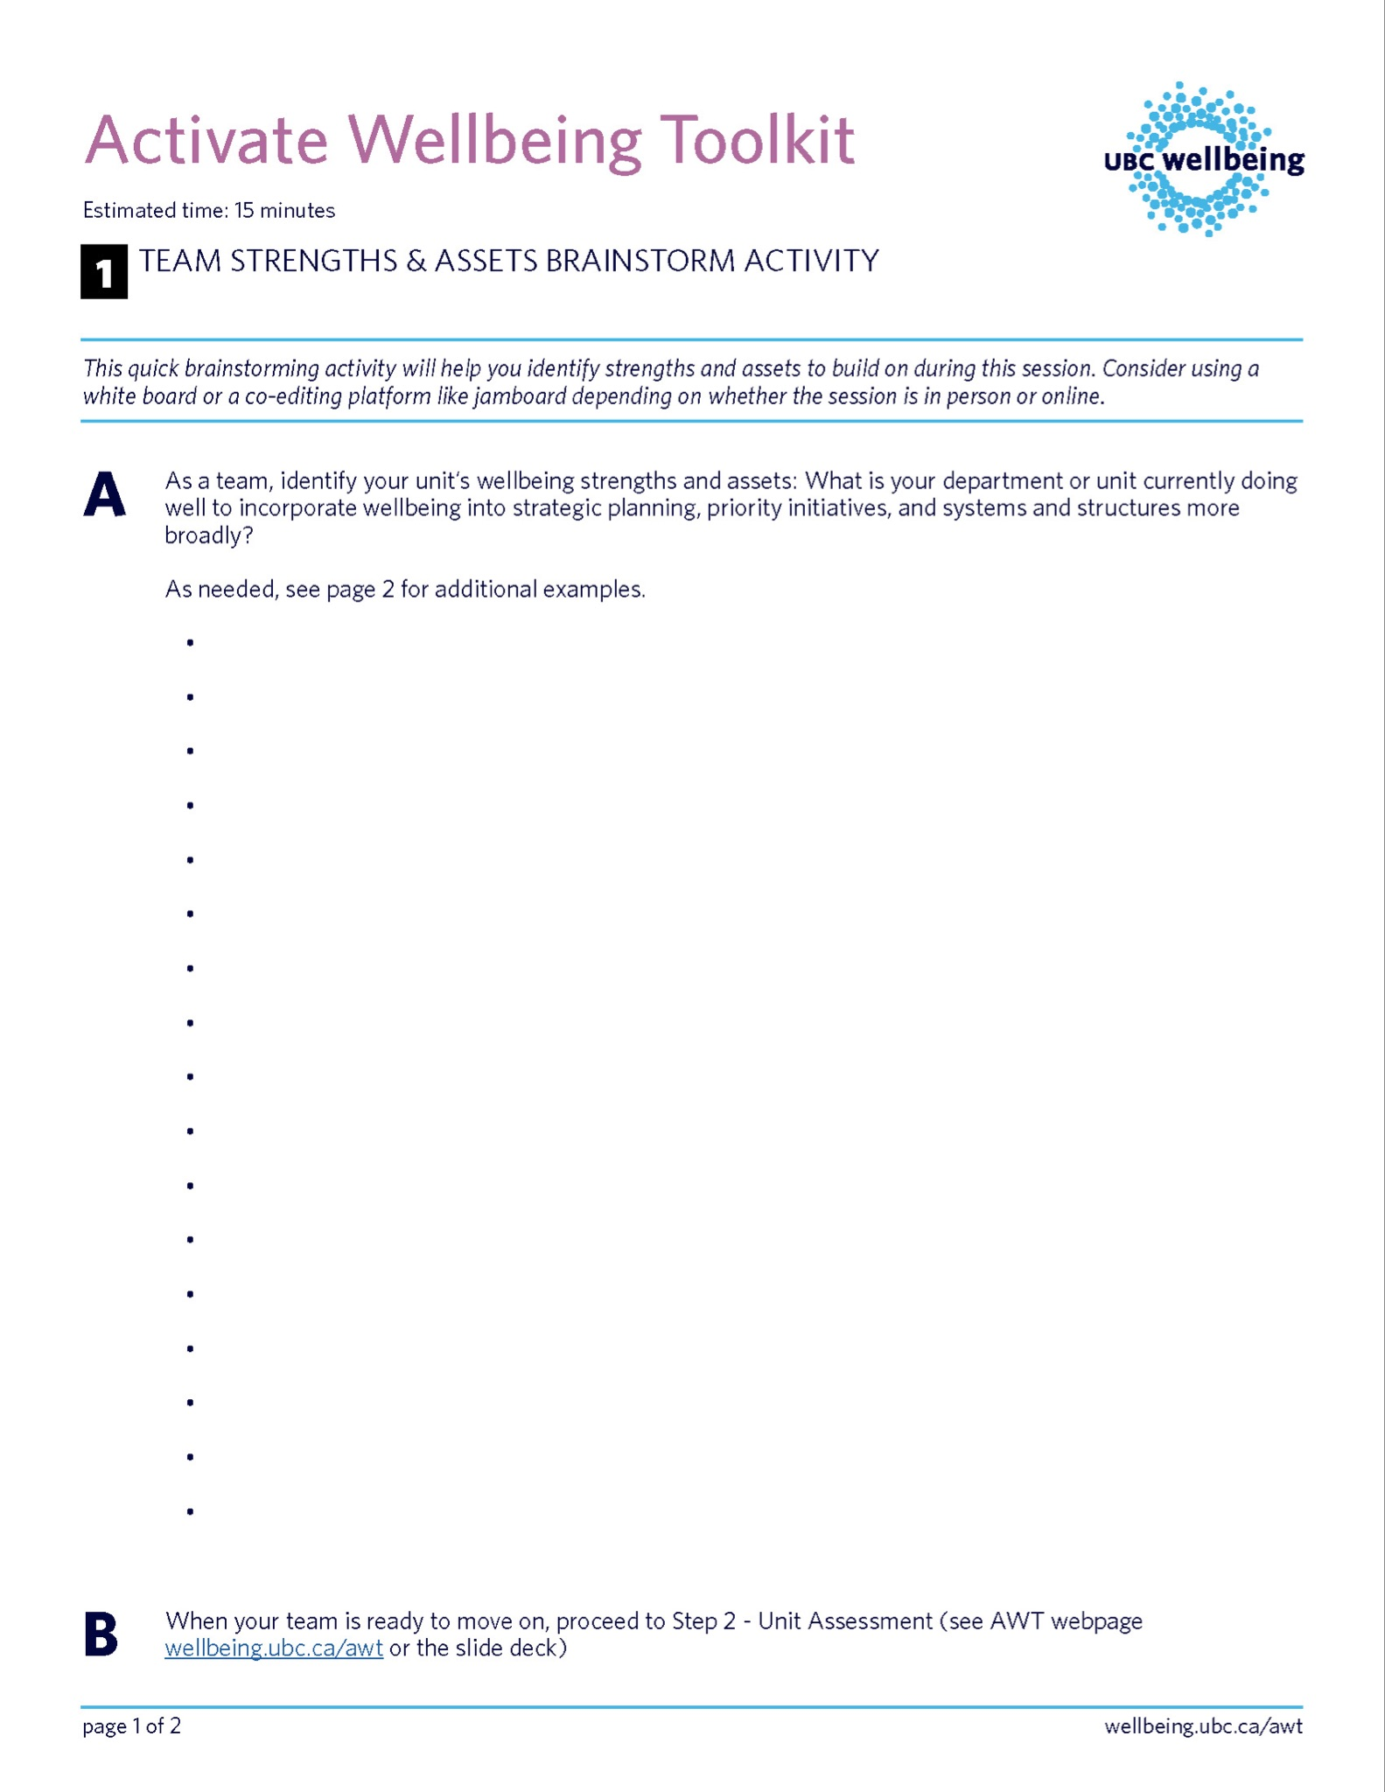
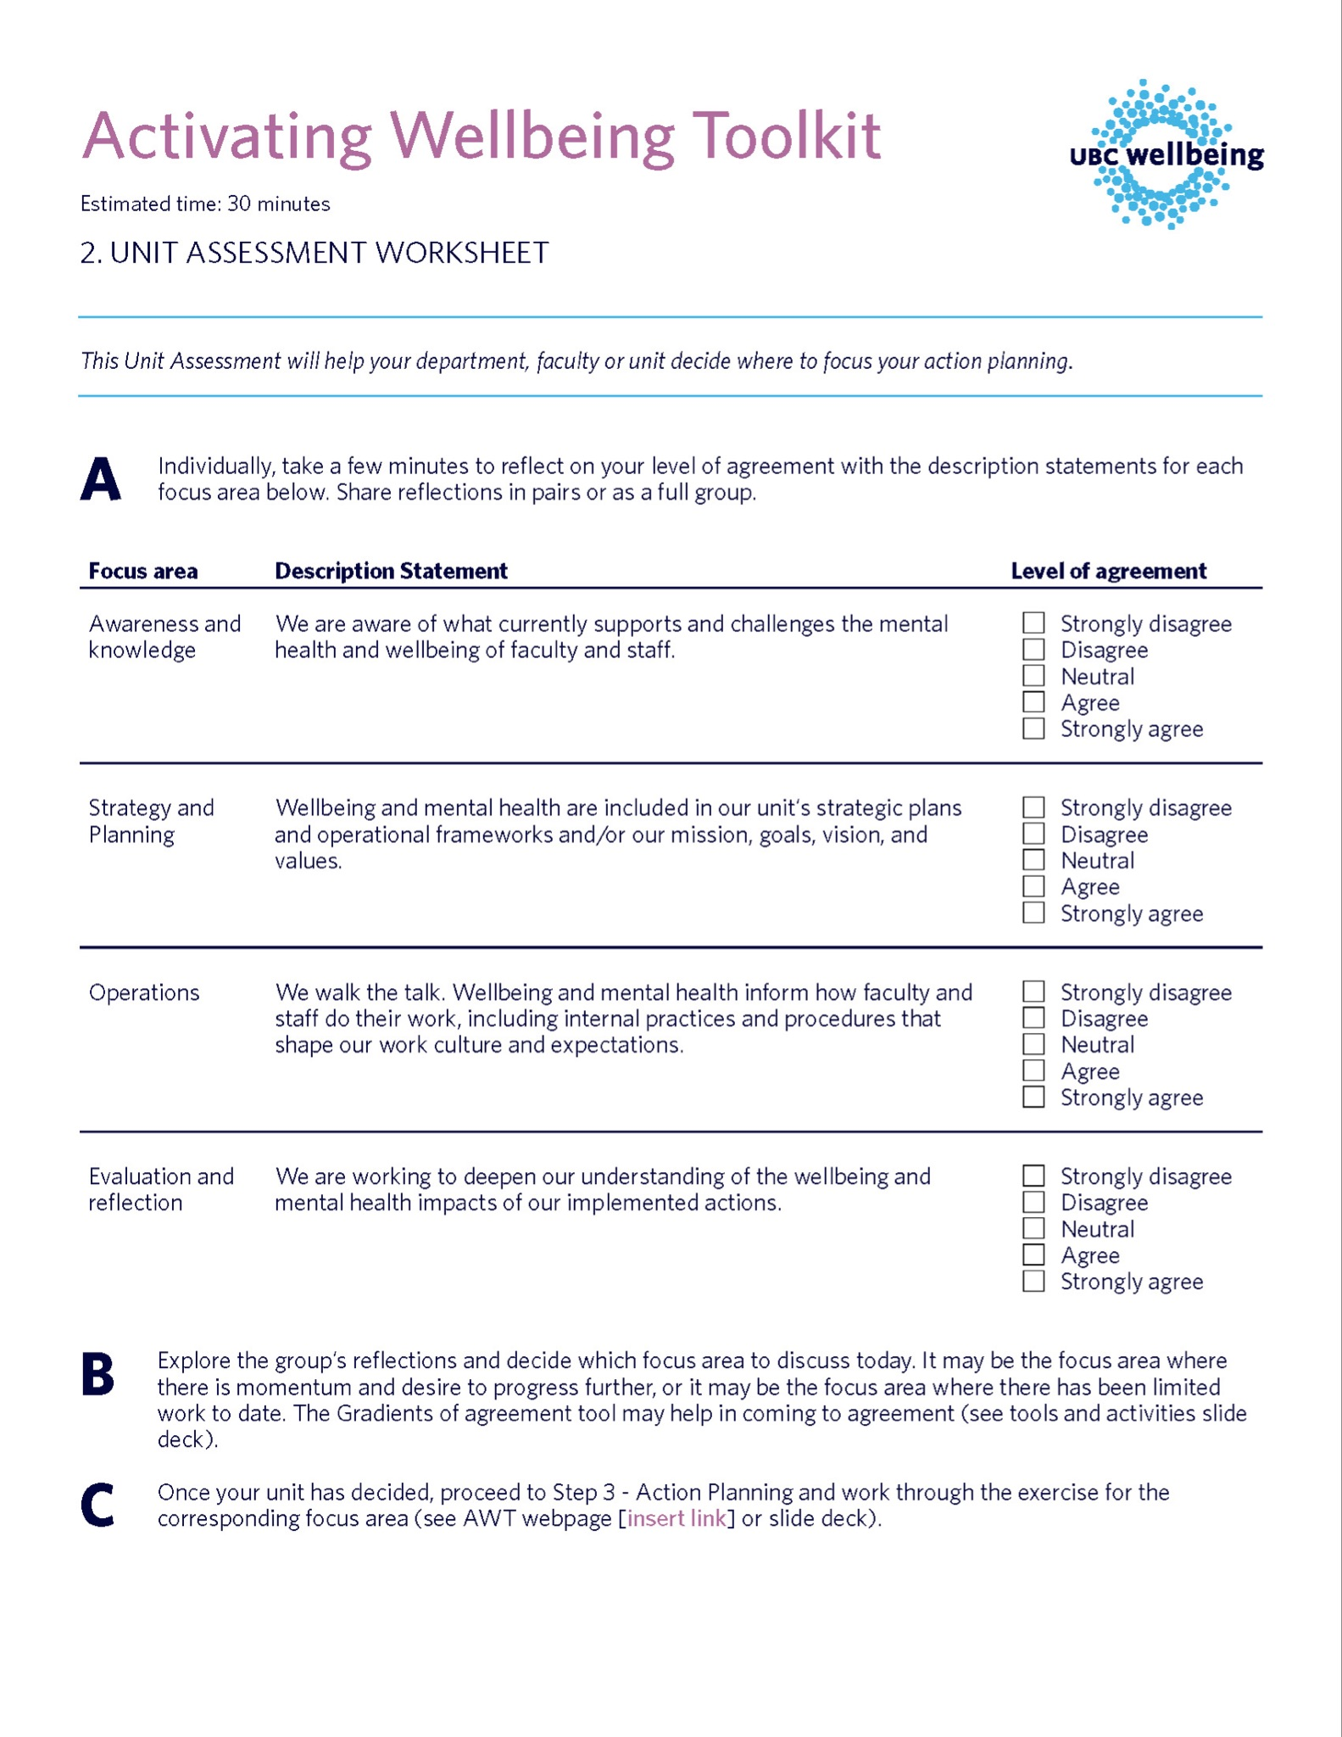
Step 1 – Strengths and Assets
Estimated Time: 15 mins
This brainstorming activity will help you identify strengths and assets to build on during this session.
Click here to work through the activity. Then, move to the next slide once complete.

Slide 16
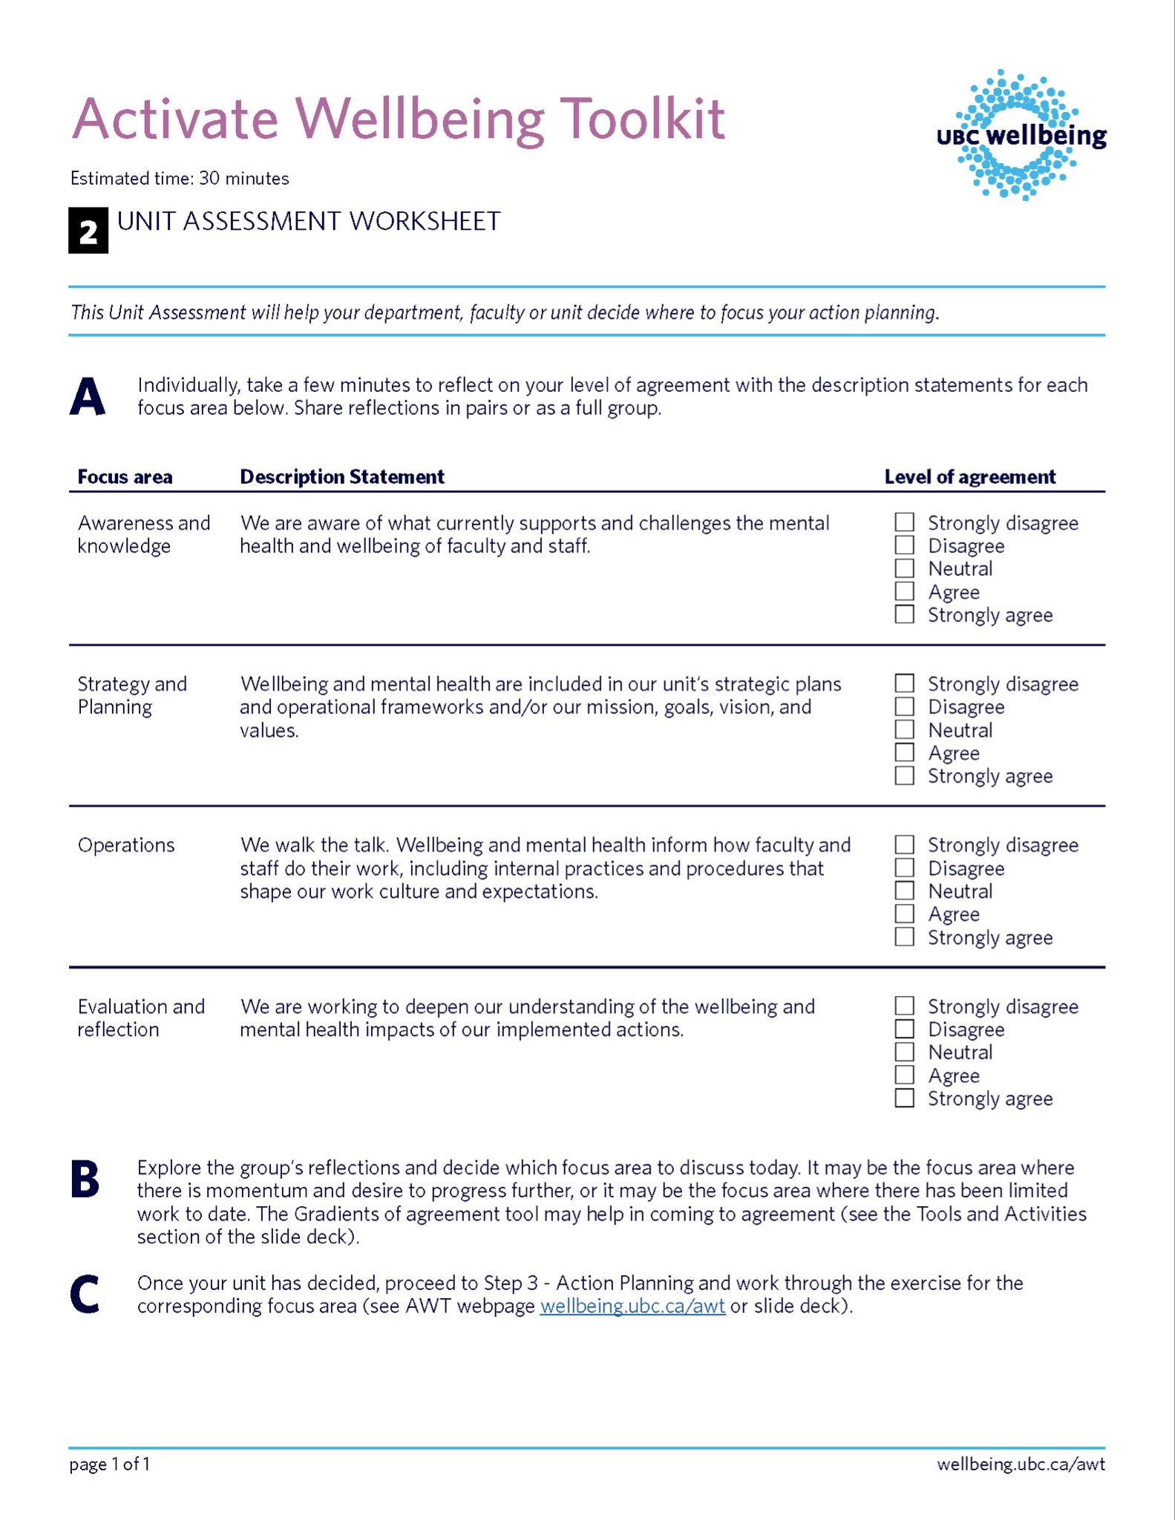
Step 2 – Unit Assessment Conversation
Estimated Time: 30 mins
This Unit Assessment will help your department, faculty or unit decide where to focus your action planning.
Click here to work through the activity. Then, move to the next slide once complete.

Slide 17
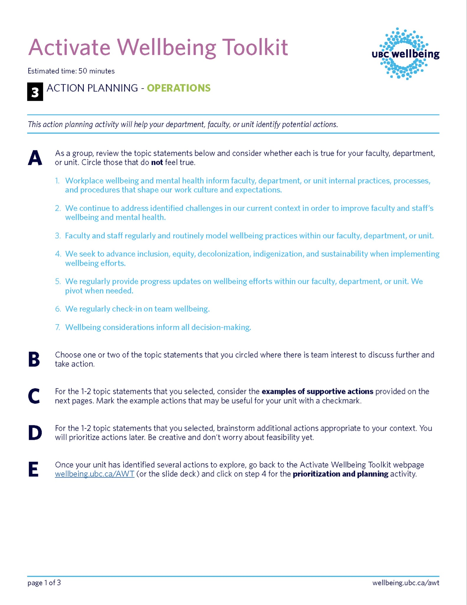
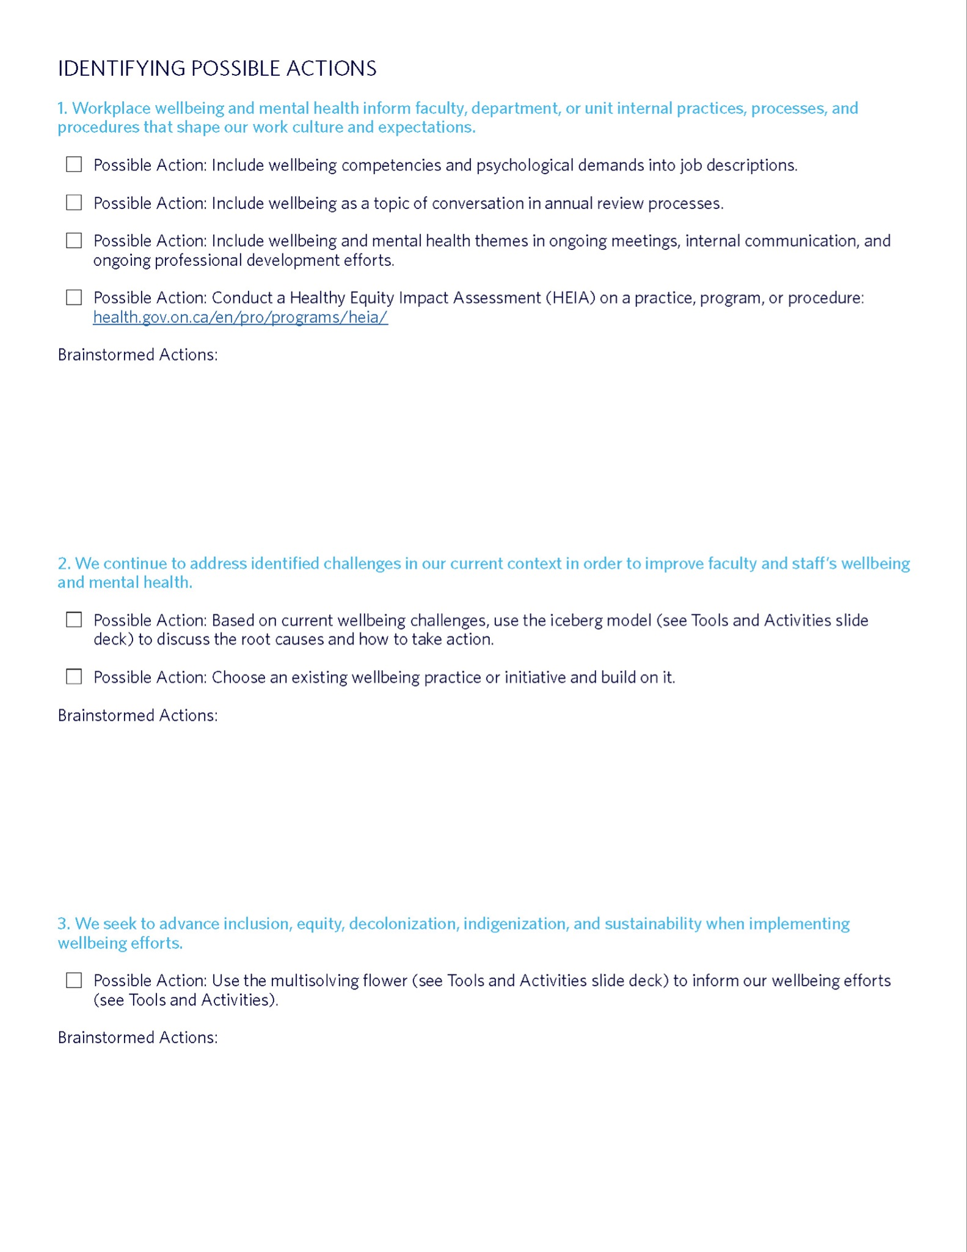
Step 3 – Identify Possible Actions
Estimated Time: 50 mins
This step will help your unit identify and brainstorm potential actions for your unit to take
Based on the focus area you selected in step 2, work through the corresponding action planning exercise for one of the following areas:
Awareness and knowledge
Strategy and planning
Operations
Evaluation and reflection
Then, move to the next slide once complete.

Slide 18
Step 4 – Prioritize Your Actions
Estimated Time: 40 mins
The step will help your unit prioritize feasible, rewarding, and energizing actions based on impact and effort, as well as capacity and the mental health of your group members.
Click here to work through the activity. Then, move to the next slide once complete.

Slide 19
Step 5 – Measure Success
Estimated Time: 20 mins
The step will help your unit define Success Criteria to help you track progress.
Click here to work through the activity. Then, move to the next slide once complete.

Slide 20
Closing and next steps
Reflect on what emerged in the session’s discussion
Summarize action(s), next steps, lead, and timing
Closing activity ideas:
One word closing: What one word describes how you are feeling after having completed this process? OR
What’s one personal commitment you plan to take?
Notes:
Note to facilitator:
Choose which closing activities you prefer
Review slides 22 and 23 to determine how you might review and assess progress

Slide 21
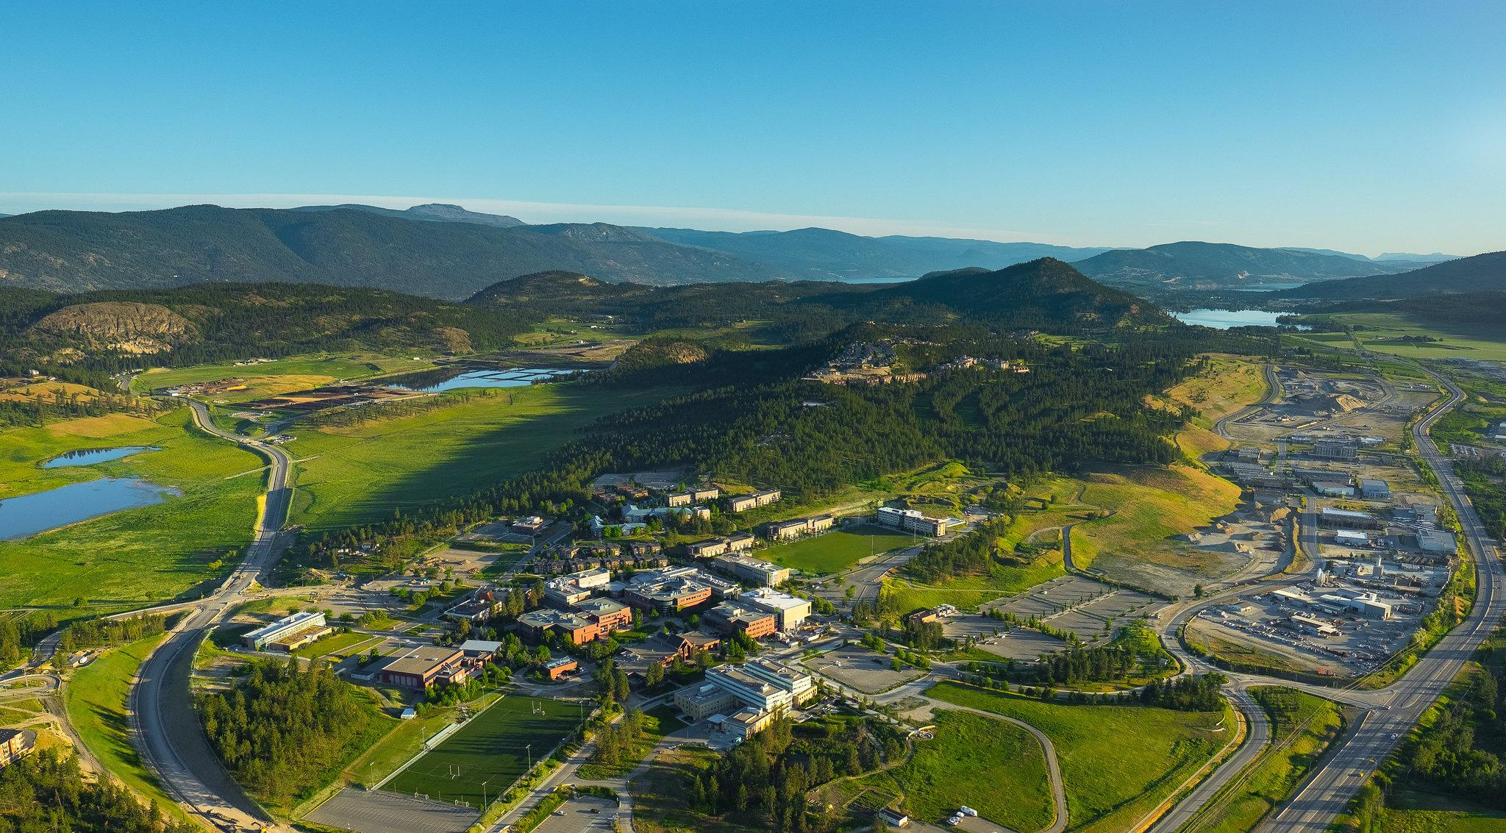
“This land doesn't belong to us. This land belongs to seven generations down the road. I pray that the water that we drink, the water that we swim in, will be there for our great great great grandchildren. As well as all over the world. I pray that the land that we walk on, the trees that we enjoy, will be there for our generations to come. These things, they all come together with health. Health of humans. Health of the animals. And health of the Mother Earth”
Closing Prayer by Okanagan Nation Elder, Grouse Barnes, at the 2015 International Conference on Health Promoting Universities and Colleges
Notes:
Quote from Elder Grouse Barnes

Slide 22
Review and assess progress
Notes:
Schedule a time for the team to come together again to review progress using these next 2 slides. The timing for this review will depend on when you hope to make progress on your actions.
Once you return at that time, explore the evaluation questions on the following 2 slides together (20-40 minutes). This is the best way to surface and embed learnings along the way.
Alternately, you may choose instead to more quickly review actions completed to date in order to determine immediate next steps required to continue to progress action.

Slide 23
Determine how to review progress and next steps following completion of identified actions
Estimated Time: 20-40 mins
Evaluation Questions your team may consider as you review progress together:
What impacts did this work have on your team’s wellbeing?
Were identified actions completed?
What did your team learn from the process? Did anything surprise you? Can any of these learnings be embedded into next steps?
Did your team meet your success criteria? Why or why not? What further action may be needed?
Considering what your team has accomplished to date regarding wellbeing action, what are team members most proud of?
Notes:
Some additional probing questions are provided below to help guide discussion:
What impacts did this work have on your team’s wellbeing? (Consider psychological safety, social connection, physical activity, mental health and resilience, food and nutrition, and built and natural environments). Was the work on this manageable for your team? When considering next steps, are any shifts needed (such as scoping/scheduling/focus)?
Were identified actions completed? Why or why not? What internal factors influenced this (within your unit’s control)? What external factors (outside your unit’s control)?
What did your team learn from the process? Did anything surprise you? Can any of these learnings be embedded into next steps?
Did your team meet your success criteria? Why or why not? What further action may be needed?
Considering what your team has accomplished to date regarding wellbeing action, what are team members most proud of?

Slide 24
Determine how to review progress and next steps following completion of identified actions
Consider
Has the context or conditions changed or is there new information?
Does your team have capacity?
You have choices!
Continue to focus on prioritized actions (from step 4) that you haven’t yet completed. OR
Return to your list of prioritized actions (from step 4) to choose which of your pre-identified actions to focus on next. OR
Return to your unit assessment (step 2) to reassess where to focus now. OR
Return to identify other actions (step 3) if you want to better understand where you are currently and what actions to focus on.
Notes:
How much time is needed? Who will lead each action?

Slide 25
Share action and outcomes

Slide 26
Share action and outcomes
We would love to hear about your engagement with the Activate Wellbeing Toolkit.
Please share your feedback, ideas, and of course the actions you are taking toward stronger mental health and wellbeing via this quick survey.
Survey link: https://ubc.ca1.qualtrics.com/jfe/form/SV_3VohbjHCvUQKZzU
You can also email us with any questions or comments at ubc.wellbeing@ubc.ca

