Slide 1

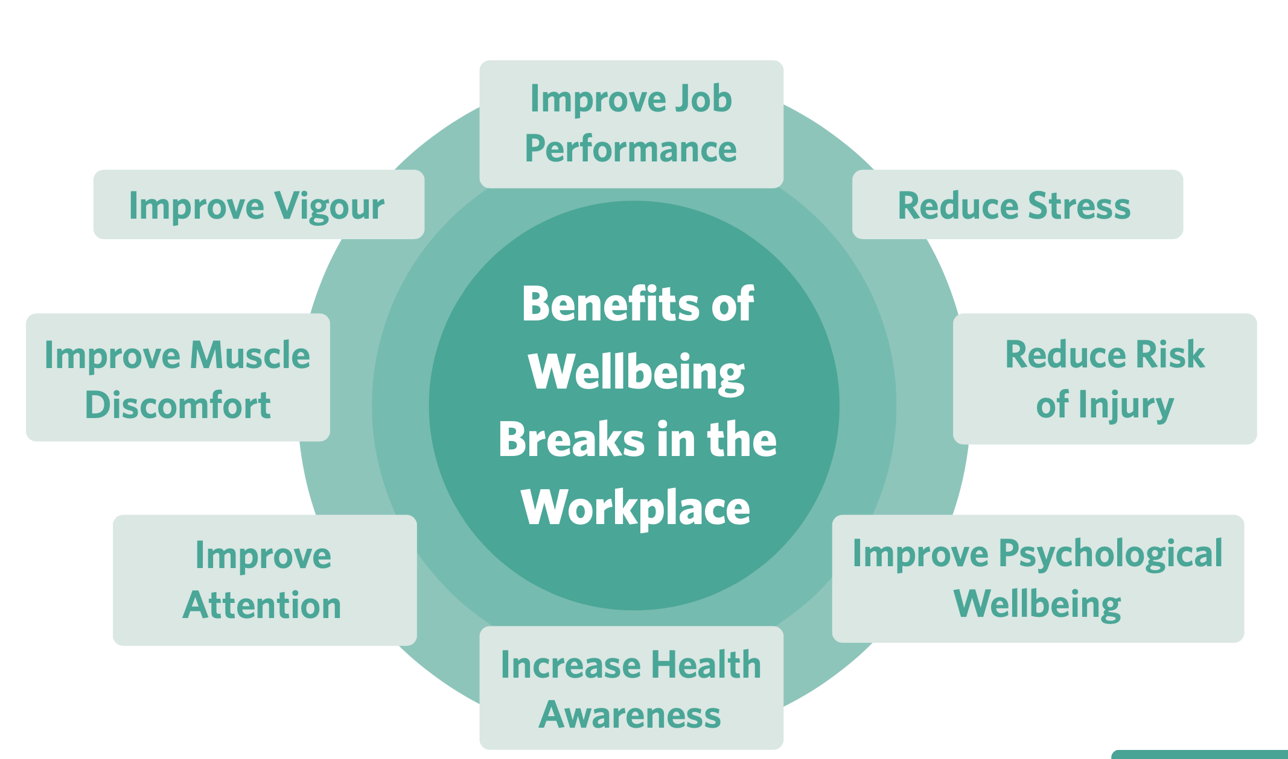
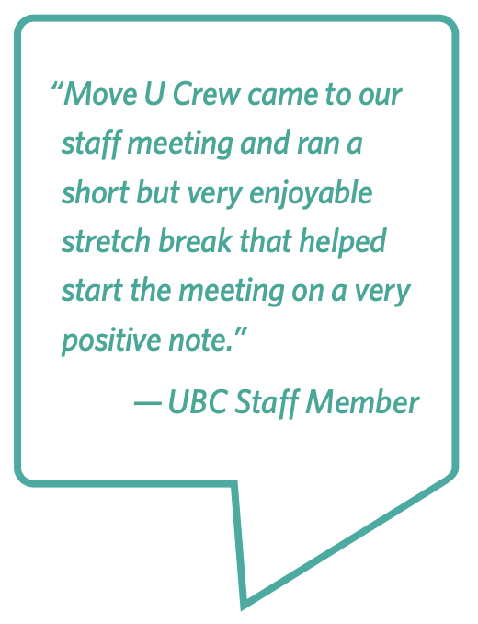

Wellbeing Breaks
Goal: Integrate brief movement throughout the workday to reduce sedentary behaviour and improve physical and mental wellbeing in the UBC community.
A commitment to provide a wellbeing break every 60-minutes in seated meetings, workshops, or gatherings
Breaks can be a guided movement break, mindful moment, or an opportunity for social connection
Why Should We Provide Wellbeing Breaks
Taking brief breaks can help to reduce stress, improve mood, improve productivity, and ultimately enhance mental wellbeing
About 47% of UBC students and 25% of UBC faculty and staff were considered to have low mental wellbeing according to a 14-item self-reported measurement tool
Only 1 in 7 UBC students and 1 in 4 UBC faculty and staff are meeting the sedentary behaviour recommendations of the Canadian 24-Hour Movement Guidelines
Demonstrates department’s commitment to wellbeing in the workplace

